Slide 1
Report On Payroll Accounting And Pension Plan.

Slide 2
PAYROLL ACCOUNTING
Payroll pertains to both salaries and wages.
Managerial, administrative, and sales personnel are generally paid salaries. Salaries are often expressed in terms of a specified amount per month or year.
Store clerks, factory employees and manual laborers are normally paid wages-based on a rate per hour.
Payments made to professional individuals who are independent contractors are called fees.
Government regulations relating to the payment and reporting of payroll taxes apply only to employees.
Notes:
17

Slide 3
INTERNAL CONTROLS FOR PAYROLL
The objectives of internal accounting control concerning payroll are:
1 To safeguard company assets from unauthorized payments of payrolls and
2 To ensure the accuracy and reliability of the accounting records pertaining to payrolls.
Payroll activities involve four functions:
1 Hiring employees,
2 Timekeeping,
3 Preparing the payroll, and
4 Paying the payroll.
Notes:
18

Slide 4

HIRING EMPLOYEES
The human resources department is responsible for ensuring the accuracy of the personnel authorization form.
The human resources department is also responsible for authorizing changes in employment status:
1 Changes in pay rates
2 Termination of employment.

Slide 5
TIMEKEEPING
Hourly employees are usually required to record time worked by “punching” a time clock. Times of arrival and departure are automatically recorded by the employee by inserting a time card into the clock.
In large companies time clock procedures are often monitored by a supervisor or security guard to make sure an employee punches only one card.
The employee’s supervisor:
1 Approves the hours shown by signing the time card at the end of the pay period and
2 Authorizes any overtime hours for an employee.

Slide 6

PREPARING THE PAYROLL
The payroll is prepared in the payroll department on the basis of two inputs:
1 Human resources department authorizations
2 Approved time cards.

Slide 7
DETERMINING AND PAYING THE PAYROLL
Determining the payroll involves computing three amounts:
1 Gross earnings
2 Payroll deductions
3 Net pay
The payroll is paid by the treasurer’s department.
1 Payment by check minimizes the risk of loss from theft.
2 The endorsed check provides proof of payment.

Slide 8
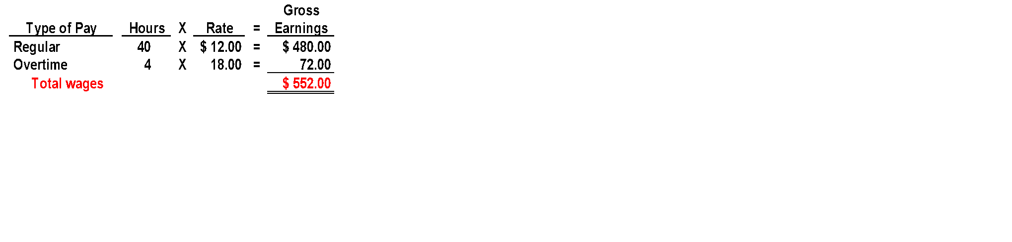
COMPUTATION OF TOTAL WAGES
Gross earnings is the total compensation earned by an employee.
It consists of wages or salaries, plus any bonuses and commissions.
Total wages are determined by multiplying the hours worked by the hourly rate of pay.
Most companies are required to pay a minimum of 1 1/2 the regular hourly rate for overtime work.
Notes:
19

Slide 9
PAYROLL DEDUCTIONS
The difference between gross pay and the amount actually received is attributable to payroll deductions.
Mandatory deductions consist of income taxes.
The employer is merely a collection agent and subsequently transfers the amounts deducted to the government and designated recipients.
Notes:
20

Slide 10
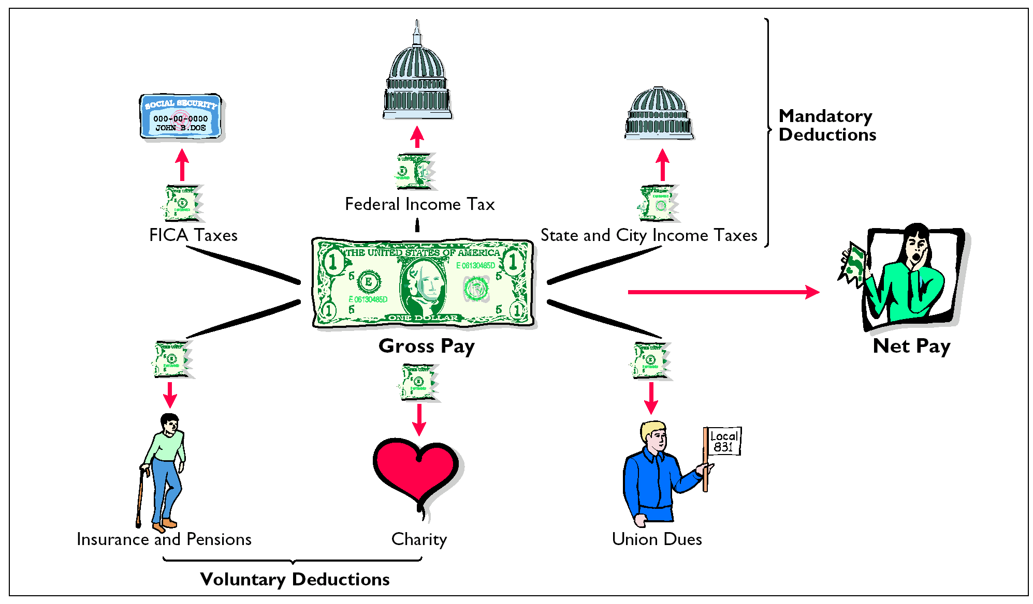
PAYROLL DEDUCTIONS

Slide 11

INCOME TAXES
Income Taxes are required to be withheld from employees each pay period
Amount is determined by 3 variables:
1 The employee’s gross earnings
2 The number of allowances claimed by the employee
3 The length of the pay period
To indicate to the Internal Revenue Service the number of allowances claimed, the employee must complete an Employee’s Withholding Certificate.
Notes:
22

Slide 12

VOLUNTARY DEDUCTIONS
Voluntary Deductions
  pertain to withholdings for charitable, retirement, and other purposes
  authorized in writing by the employee.
Notes:
23

Slide 13
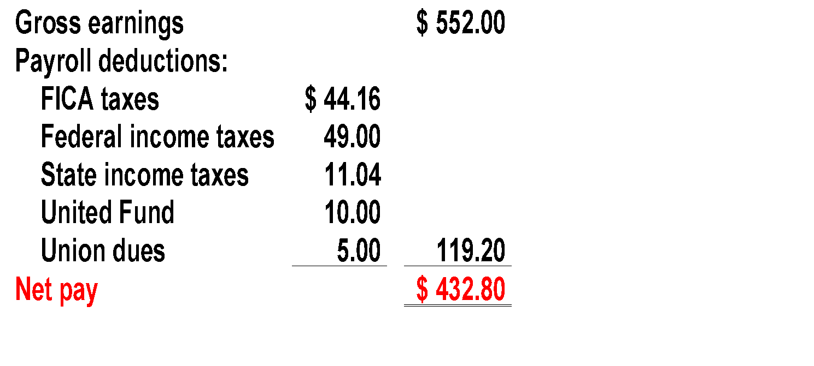
COMPUTATION OF NET PAY
Net Pay (or take-home pay) is determined by subtracting payroll deductions from gross earnings. Assuming an employee’s wages are ₦552 each week, the employee will earn ₦28,704 for the year (52 weeks X ₦552). Thus, all earnings are subject to FICA taxes.
Notes:
24

Slide 14
RECORDING THE PAYROLL
Employee earnings record
1. File state and federal payroll tax returns
2. Provides each employee with a statement of gross earnings and tax withholdings for the year
Many companies use a payroll register to accumulate the gross earnings, deductions, and net pay by employee for each period.
Notes:
25

Slide 15

RECOGNIZING PAYROLL EXPENSES AND LIABILITIES
Jan 14 Office Salaries Expense 5,200.00
Wages Expense 12,010.00
FICA 1,376.80
Federal Income Taxes Pay. 3,490.00
State Income Taxes Pay. 344.20
United Fund Pay. 421.50
Union Dues Pay. 115.00
Salaries and Wages Pay. 11,462.50
Academy Company records its payroll for the week ending January 14, 2005 with the journal entry above. Office Salaries Expense (₦5,200) and Wages Payable (₦12,010) are debited in total for ₦17,210 in gross earnings. Specific liability accounts are credited for the deductions made during the pay period. Salaries and Wages Payable is credited for ₦11,462.50 in net earnings.

Slide 16
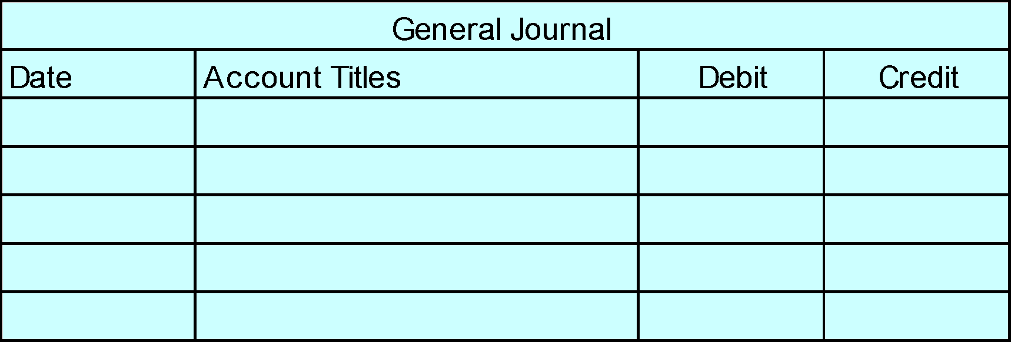
RECORDING PAYMENT OF THE PAYROLL
Jan. 14 Salaries and Wages Pay. 11,462.50
Cash 11,462.50
The entry to record payment of the Academy Company payroll is a debit to Salaries and Wages Payable and a credit to Cash. When currency is used in payment, one check is prepared for the amount of net earnings (₦11,462.50).
Notes:
27

Slide 17
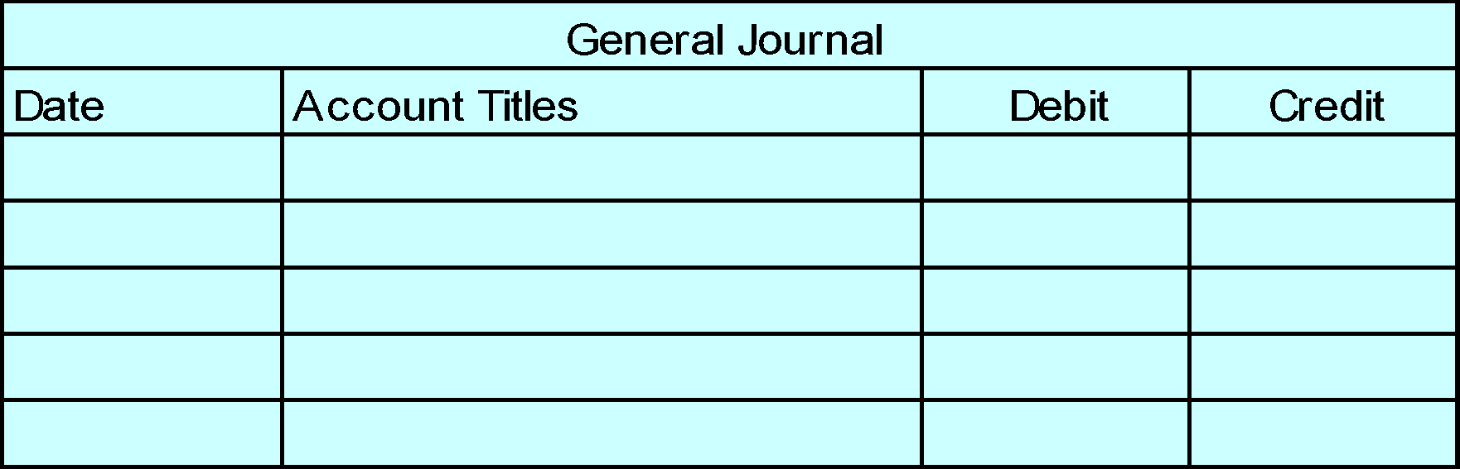
RECORDING EMPLOYER PAYROLL TAXES
The entry to record the payroll tax expense associated with the Academy Company payroll results in a debit to Payroll Tax Expense for ₦2,443.82, a credit to FICA Taxes Payable for ₦1,376.80 (₦17,210 X 8%), a credit to FUTA Payable for ₦137.68 (₦17,210 X 0.8%), and a credit to SUTA Payable for ₦929.34 (₦17,210 X 5.4%).
RECORDING EMPLOYER
PAYROLL TAXES
Jan 14. Payroll Tax Expense 2,443.82
FICA Taxes Pay 1,376.80
Federal Unemployment Taxes Pay 137.68
State Unemployment Taxes Pay 929.34

Slide 18
Additional Fringe Benefits
................................

Slide 19
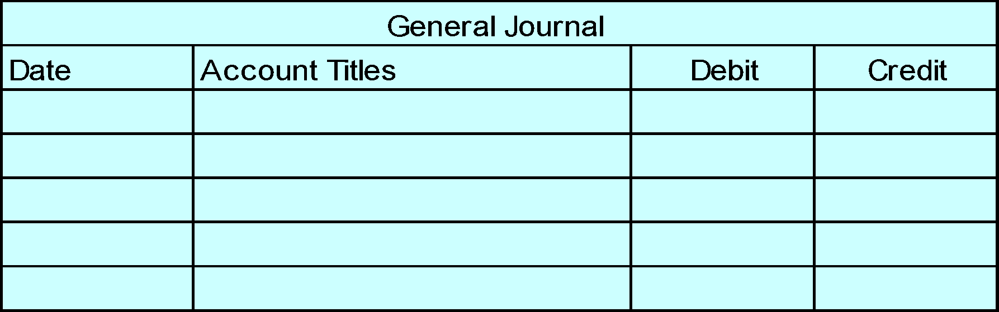
ADDITIONAL FRINGE BENEFITS
PAID ABSENCES
Employees often are given rights to receive compensation for absences when certain conditions of employment are met. Such compensation may relate to 1) paid vacations, 2) sick pay benefits, and 3) paid holidays. A liability should be accrued for paid future absences if 1) its payment is probable and 2) the amount can be reasonably estimated. Academy Company employees are entitled to one day’s vacation for each month worked. If 30 employees earn an average of ₦110 per day in a given month, the accrual for vacation benefits for January is ₦3,300 (₦110 X 30). The liability is recognized at January 31 by the following adjusting entry:
Jan. 31 Vacation Benefits Exp. 3,300
Vacation Benefits Pay 3,300

Slide 20
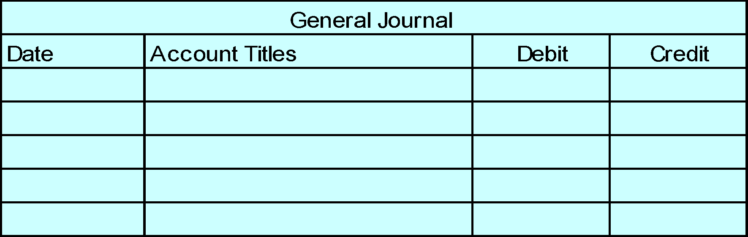
ADDITIONAL FRINGE BENEFITS PAID ABSENCES
When vacation benefits are paid, Vacation Benefits Payable is debited and Cash is credited. If Academy Company pays such benefits for 10 employees in July, the journal entry to record the payment is for ₦1,100 (₦110 X 10).
July 31 Vacation Benefits Pay 1,100
Cash 1,100

Slide 21

POSTRETIREMENT BENEFITS
Postretirement benefits are benefits provided by employers to retired employees for:
1 Health care and life insurance
2 Pensions
Both types of postretirement benefits are accounted for on the accrual basis.
Notes:
31

Slide 22
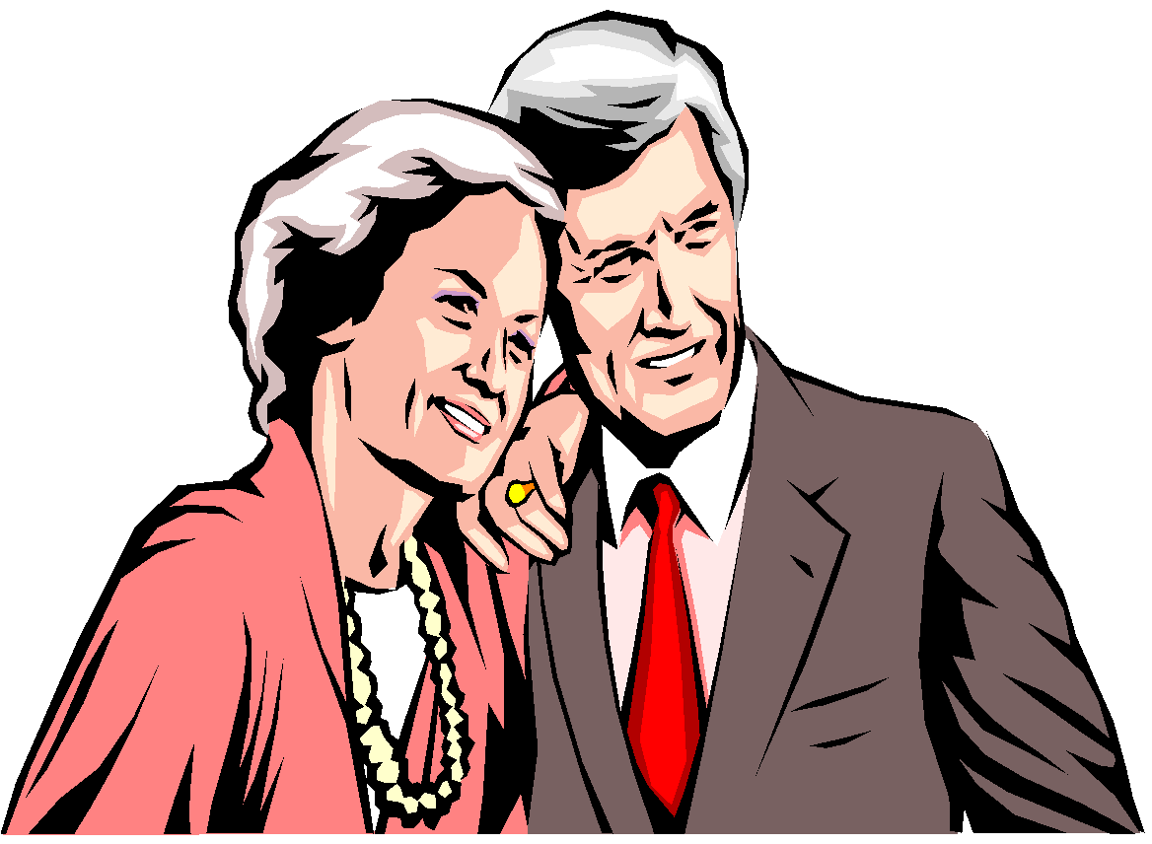
PENSION PLANS
A pension plan is an agreement whereby an employer provides benefits to employees after they retire.
Three parties are generally involved in a pension plan.
1 The employer sponsors the pension plan.
2 The plan administrator receives the contributions from the employer, invests the pension assets, and makes the benefit payments.
3 The retired employees receive the pension payments.
Notes:
32

Slide 23

PARTIES IN A PENSION PLAN
Employer
Benefits
Plan Administrator
Pension Recipients
Contributions

